Slide 1
CHAPTER 2
ELECTRONICS FOR TELECOMMUNICATIONS

Slide 2
Introduction
Electromagnetic (E/M) Spectrum
  Ranges from 30 Hz to several GHz
  FCC jurisdiction over the use of this spectrum
Block diagram of an electronic communications system
Transmitter
Receiver

Slide 3
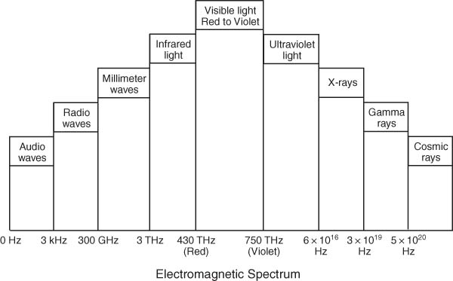
E/M Spectrum

Slide 4
Communications System Parameters
Type of Information
Bandwidth
Broadband versus Baseband
Synchronous versus Asynchronous
Simplex, Half-Duplex and Full-Duplex
Serial versus Parallel
Analog versus Digital
Noise

Slide 5
Type of Information
Data, Voice and Video, each have specific transmission requirements

Slide 6
Bandwidth
Range of frequencies that can be transmitted with minimal distortion
Measure of transmission capacity of the communications medium
Hartley’s law states that the amount of information that can be transmitted is directly proportional to bandwidth and transmission time I = ktBW
Analog: BW is expressed in Hz
Digital: BW is expressed in bps

Slide 7
Broadband versus Baseband
Broadband
  Simultaneous transmission of multiple channels over a single line
  Originated in the CATV industry
Baseband
  Digital transmission of a single channel
  Advantages: Low-cost, Ease of installation, and High transmission rates

Slide 8
Synchronous versus Asynchronous
Asynchronous
  Transmission of a single character
  Incorporates framing bits (start and stop bits)
  More cost-effective but inefficient
Synchronous
  Transmission of a block of data
  Requires a data clock
  SYN bits transmitted at the beginning of a data block
  Expensive and complex but extremely efficient

Slide 9


Efficiency of Transmission
where: M = Number of message bits
C = Number of control bits
Efficiency % = 100 – Overhead %

Slide 10
Simplex, Half-Duplex and Full-Duplex
Simplex
  In only one direction from transmitter to receiver
  Example: radio
Half-Duplex
  Two-way communications but in only one direction at a time
  Example: walkie-talkie
Full-Duplex
  Simultaneous two-way communications
  Example: videoconferencing

Slide 11
Serial versus Parallel
Serial
  Transmitting bits one after another along a single path
  Slow, cost-effective, has relatively few errors, practical for long distances
Parallel
  Transmitting a group of bits at a single instant in time, which requires multiple paths
  Fast but expensive, practical for short distances

Slide 12
UART
Universal Asynchronous Receiver Transmitter (UART): Parallel to Serial converter
  Transmit section
    Parallel data is put on an internal data bus, then stored in a buffer storage register from where it is sent to a shift register, which adds start and stop bits, and a parity bit. The data is then transmitted one bit at a time to a serial interface.
  Receive section
    Serial data is shifted into a shift register where start, stop and parity bits are stripped off. The remaining data is transferred to a buffer storage register and then on to the internal data bus.

Slide 13
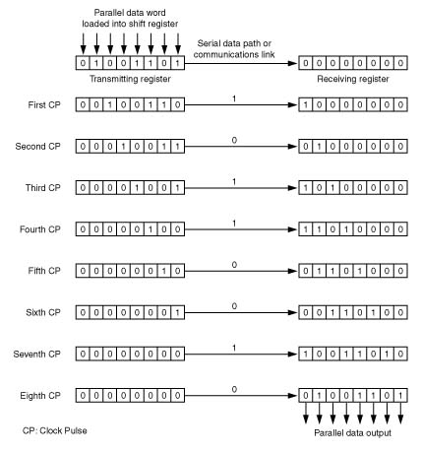
Parallel-to-Serial and Serial-to-Parallel Data Transfer with Shift Registers

Slide 14
Analog versus Digital
Analog
  Continuously varying quantities
Digital
  Discrete quantities
  Most commonly binary
  All information is reduced to a stream of 0s and 1s which enables the use of a single network for voice, data and video
  Digital circuits are cheaper, more accurate, more reliable, have fewer transmission errors and are easier to maintain than analog circuits

Slide 15
Analog-to-Digital Conversion
Analog-to-Digital conversion device is also referred to as a codec (coder-decoder).
An everyday example of such a device is the modem (modulator/demodulator), which converts digital signals that it receives from a serial interface of a computer into analog signals for transmission over the telephone local loop, and vice versa.

Slide 16
Noise
External Noise: Originates in the communication medium
  Man-made noise
    Generated by equipment such as motors
  Atmospheric noise (also called static)
    Dominates at lower frequencies and typical solution involves “noise blanking”
  Space noise (Mostly solar noise)
    Dominates at higher frequencies and can be a serious problem in satellite communications

Slide 17
Noise
Internal Noise: Originates in the communication equipment
  Thermal noise (also called white noise)
    Is produced by random motion of electrons in a conductor due to heat
    Noise Power in watts is directly proportional to Bandwidth in Hz, and the temperature in degrees Kelvin
  Shot noise
  Excess noise (same as flicker noise or pink noise)

Slide 18
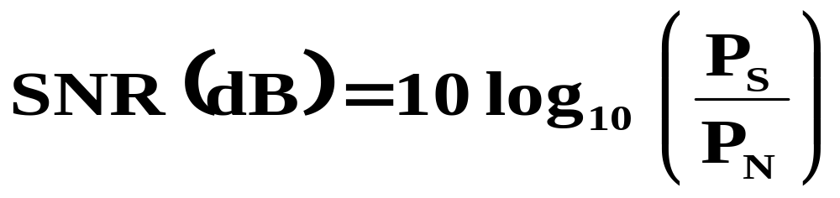
Signal-to-Noise Ratio (SNR)
Signal-to-Noise Ratio (SNR)
  Is expressed in decibels
  where: P_{S} is the signal power in watts
  P_{N} is the noise power in watts

Slide 19
Hartley-Shannon Theorem: Significance of SNR
Hartley-Shannon Theorem (also called Shannon’s Limit) states that the maximum data rate for a communications channel is determined by a channel’s bandwidth and SNR.
A SNR of zero dB means that noise power equals the signal power.

Slide 20
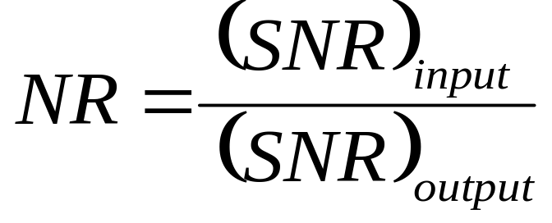
Noise Ratio (NR) and
Noise Figure (NF)
  NF = 10 log (NR)
  NF (dB) = (SNR)_{input} (dB) – (SNR)_{output} (dB)

Slide 21
Noise Effects on Communications
Data
  May be satisfactory in the presence of white noise but impulse noise will destroy a data signal
  BER (Bit Error Rate) is used as a performance measure in digital systems
Voice
  White noise (continuous disturbance) can be bothersome to humans but impulse noise can be acceptable for speech communications
  SNR (Signal-to-Noise Ratio) is used as a performance measure in analog systems

Slide 22
Modulation
Modulation
  Means of controlling the characteristics of a signal in a desired way
Fourier Analysis
  Time domain
    Graph of voltage against time
    An oscilloscope display
  Frequency domain
    Graph of amplitude or power against frequency
    A spectrum analyzer display

Slide 23
Modulation Schemes for
Radio Broadcast
Amplitude Modulation (AM)
  Oldest and simplest forms of modulation used for analog signals
  Amplitude changes in accordance with the modulating voice signal
Frequency Modulation (FM)
  Frequency changes in accordance with the modulating signal, which makes it more immune to noise than AM
  The amount of bandwidth necessary to transmit an FM signal is greater then that needed for AM

Slide 24
Frequency Shift Keying (FSK)
Frequency Shift Keying (FSK)
  Popular implementation of FM for data applications
  Was used in low-speed modems
  Carrier is switched between two frequencies, one for mark (logic 1) and the other for space (logic 0). For full-duplex, there are two pairs of mark and space frequencies

Slide 25
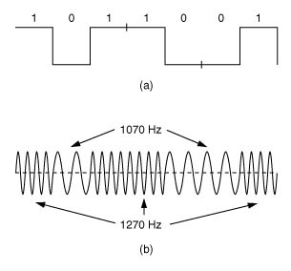
FSK Technique

Slide 26
Phase Modulation (PM)
Phase Modulation (PM)
  Amount of phase-shift changes in accordance with the modulating signal. In effect, the carrier frequency changes, and therefore, PM is sometimes referred to as “indirect FM”
  Advantage of PM over FM is that in PM, the carrier can be optimized for frequency accuracy and stability. Also, PM is adaptable to data applications

Slide 27
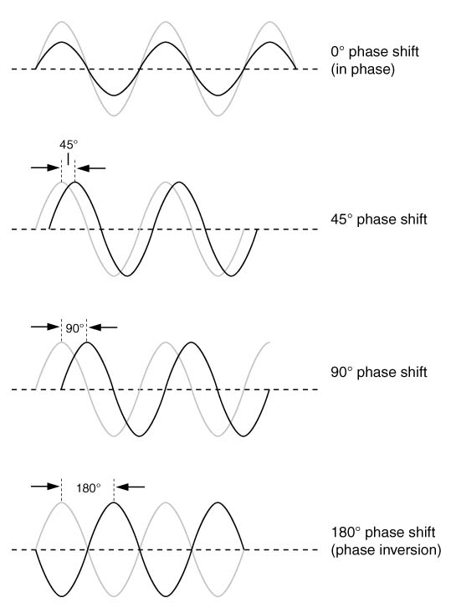
Examples of Phase Shift

Slide 28
PSK and QAM
Phase Shift Keying (PSK)
  Most popular implementation of PM for data
  In BPSK (Binary PSK): one bit per phase change
  In QPSK: two bits per phase change (symbol)
Quadrature Amplitude Modulation (QAM)
  Uses two AM carriers with 90º phase angle between them, which can be added so that the amplitude and phase angle of the output can vary continuously
  Implemented in V.32bis and V.90 modems
Bit Rate = Baud rate x Bits per Symbol

Slide 29
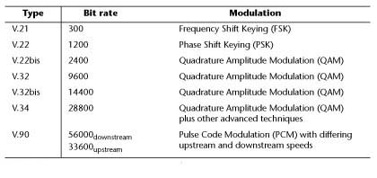
Modulation Techniques for Modems

Slide 30
Pulse Modulation
Pulse Modulation
  Used for both analog and digital signals
  Analog signals must first be converted to digital signals, which involves “sampling”
    First step is low-pass filtering of the analog signal
    Second step is sampling the analog signal at the Nyquist rate (at least twice the maximum frequency component in the waveform)
    Third step is transforming the pulses into a digital signal

Slide 31
Pulse Modulation Schemes
PAM (Pulse Amplitude Modulation)
  First important step in Pulse Code Modulation
PPM (Pulse Position Modulation)
  Random arrival time makes PPM unsuitable for transmission
PWM (Pulse Width Modulation)
  Unsuitable for transmission because of varying pulse width

Slide 32
Pulse Code Modulation
Pulse Code Modulation (PCM)
  Only technique that renders itself well to transmission, and most commonly used
  Transmitted information is coded by using a character code such as the ASCII
  T-1 uses PCM
    Allotted bandwidth per voice channel is 4 kHz
    Therefore, the Nyquist sampling rate is 8 kHz
    Eight bits per sample are coded
    Thus, each PCM channel is 64 kbps
    24 channels gives an aggregate of 1.536 Mbps, with additional 8 kbps for synchronization, giving 1.544 Mbps

Slide 33
Multiplexing
Multiplexing:
  Two or more signals are combined for transmission over a single communications path
  FDM (Frequency Division Multiplexing)
    Each signal is assigned a different carrier frequency
  TDM (Time Division Multiplexing)
    Digital transmission that is protocol insensitive
    Used in T-1s where each of the 24 channels is assigned an 8-bit time slot

Slide 34
TDM
Conventional TDM
  Bit-interleaved
    A single bit from each I/O port is output to the aggregate
    Simple, efficient, and requires no buffering of I/O data
  Byte-interleaved
    One byte from each I/O port is output to the aggregate
    Fits well with the microprocessor-driven byte-based environment
Statistical TDM
  Allocates time slices on demand
  Additional overheads (for example, station address)
  Aggregate channel BW is less than the sum of individual channel BWs
  I/O protocol sensitive

Slide 35
WDM
WDM (Wavelength Division Multiplexing)
  Cost-effective way to increase fiber capacity
  Each wavelength of light transmits information and WDM multiplexes different wavelengths
DWDM (Dense WDM) System
  Invention of the flat-gain wideband optical amplifier increased the viability of DWDM
  Typically employed at the core of carrier networks
  Affords greater bandwidth in pre-installed fibers
  Can carry different types of data (IP, ATM, SONET)
  Can carry data at different speeds

Slide 36
DWDM System Components
Transmitter:
  Semiconductor laser
Modulator/Demodulator and MUX/DeMUX:
  Electro-optical device
Receiver:
  Photodetector and Optical amplifier

